Slide 1


TSUNAMI STUDY (1750 – 2023)
By: Raul Chavez
12/26/2023

Slide 2
OUTLINE
Executive Summary
Introduction
Methodology
Results
Conclusion
Appendix

Slide 3
EXECUTIVE SUMMARY
Objective: Analyze historical tsunami data to identify trends in frequency, intensity, and impact.
Data Source: NOAA's Global Historical Tsunami Database (National Geophysical Data Center / World Data Service, 2023).
Methodology: Utilized Python (Pandas, NumPy, Matplotlib, Seaborn) for data preprocessing and statistical analysis. Utilized tableau for data visualization and dashboard creation.
Key Insights: Rising tsunami occurrences over time, mostly earthquake-triggered near the equator—particularly in Japan, Indonesia, and the US—with varying impacts; intense events correlate with higher fatalities, while economic damage is not strictly related to seismic intensity.
Challenges and Limitations: Historical data may underrepresent true event frequencies due to earlier limitations in detection and reporting, with potential biases in records affecting the accuracy of trend analyses, especially for earlier centuries.
Future Work: Incorporating advanced predictive analytics and machine learning models to better anticipate tsunami impacts, along with integrating more granular geographic and environmental data to refine risk assessments and preparedness strategies.
Impact: Provides foundational analysis that can inform local disaster preparedness initiatives, with the potential to improve community awareness and emergency response plans in tsunami-prone areas.

Slide 4
INTRODUCTION
In this data science project, we delve into an extensive historical analysis of tsunami events from 1750 through 2023. Utilizing a comprehensive dataset from the National Oceanic and Atmospheric Administration (NOAA), we aim to uncover trends and patterns in tsunami occurrences, their causes, physical characteristics, and their impacts on human life and property. This report presents a synthesis of our findings, offering insights into the temporal and geographical distribution of tsunamis, the relationship between seismic activity and tsunami intensity, and the consequent effects on affected regions. Our analysis not only sheds light on the historical context of these natural disasters but also seeks to contribute to the broader understanding of tsunami dynamics, aiding in future risk mitigation and preparedness strategies.

Slide 5
METHODOLOGY
Data Collection: Acquired historical tsunami data directly from the National Oceanic and Atmospheric Administration (NOAA) database, spanning events from 1750 to 2023.
Data Wrangling: Implemented data cleaning processes to address missing values, eliminate duplicates, and standardize the dataset for consistency and accuracy.
Exploratory Data Analysis (EDA): Performed detailed statistical analysis to determine the distribution of events, pinpoint outliers, and explore correlations between key variables.
Data Visualization: Developed various visualizations, including histograms, box plots, scatter plots, and bubble plots, to reveal underlying patterns and insights.
Dashboard Creation: Constructed interactive Tableau dashboards that allow for intuitive exploration of the tsunami data, facilitating a clear understanding of the trends and impacts.

Slide 6
RESULTS

Slide 7
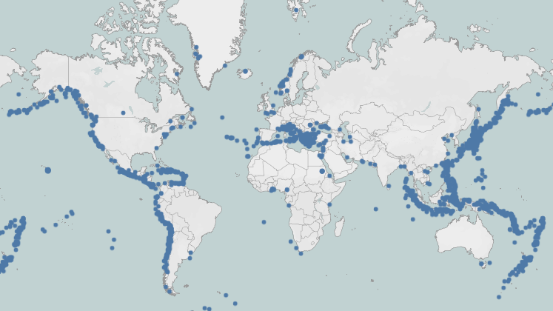

Slide 8
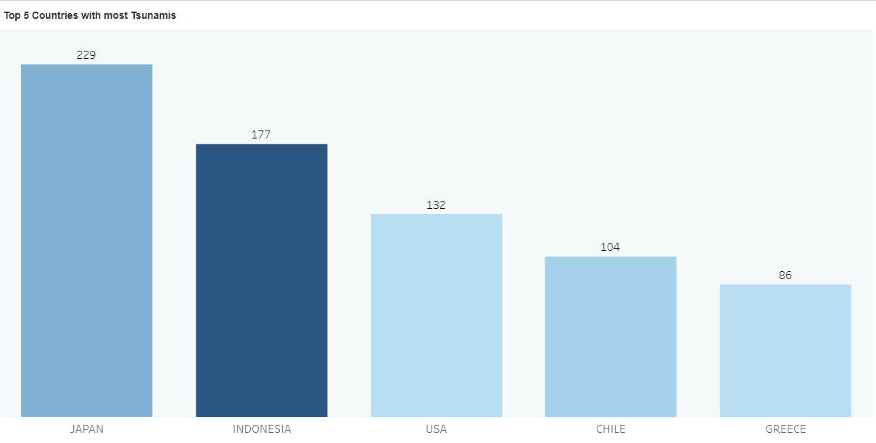
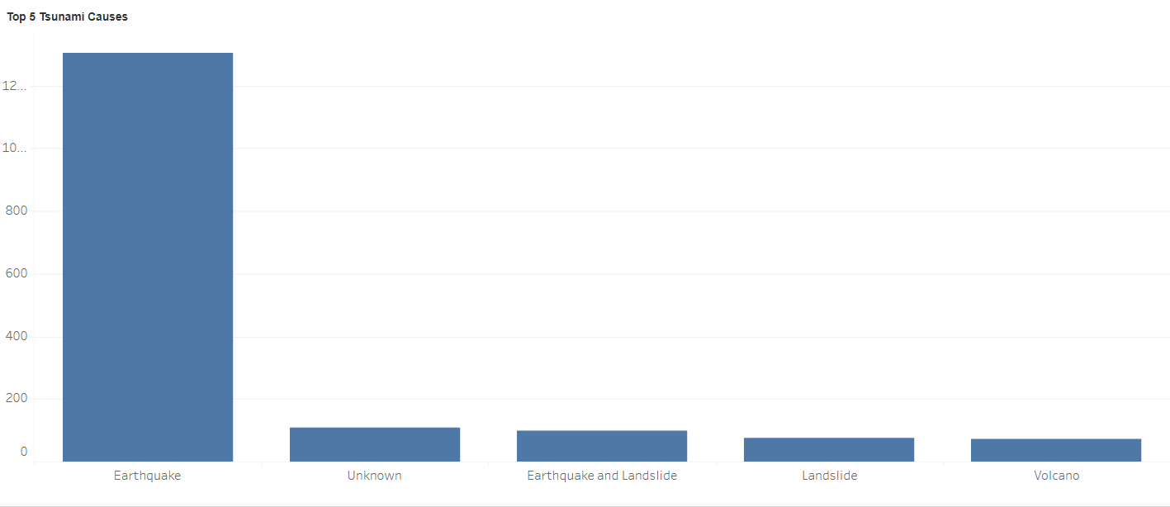

Slide 9
FINDINGS
Primary Cause - Earthquakes: Earthquakes are the predominant cause of tsunamis, with the data showing a significant majority of tsunami events being earthquake-induced.
Geographical Hotspots: Japan, Indonesia, and the USA (especially along the Pacific Rim) are the countries most affected by tsunamis. This underscores the risk associated with tectonic activity in the Pacific Ring of Fire.

Slide 10
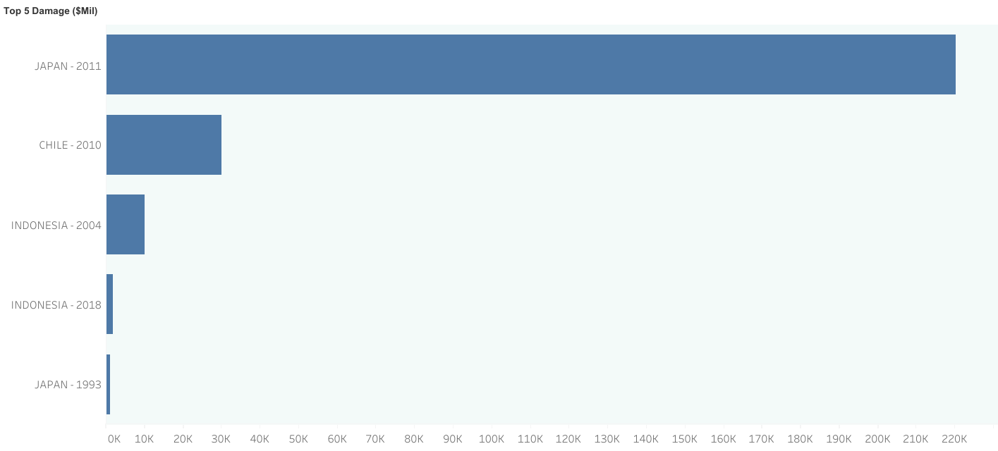
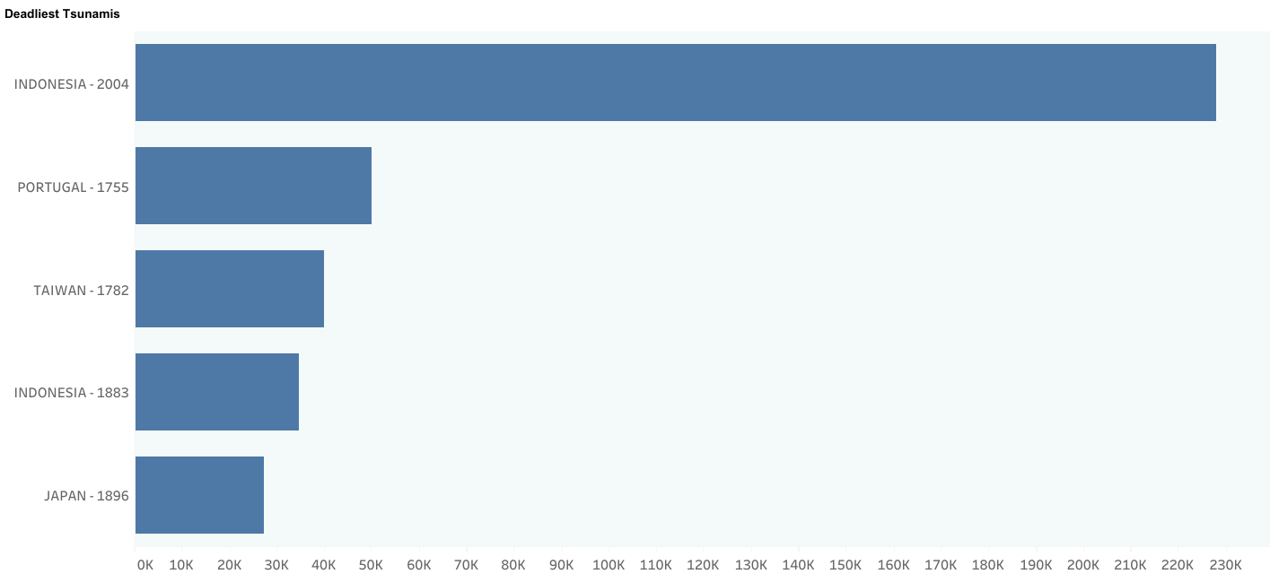

Slide 11
FINDINGS
Deadliest Events: The 2004 tsunami in Indonesia is recorded as the deadliest event, followed by historical tsunamis in Portugal (1755) and other countries. This suggests that while tsunamis can be catastrophic anywhere, certain regions are at higher risk of deadly impact.
Economic Impact: The 2011 event in Japan has been the most financially damaging tsunami recorded in the dataset, which points to the potential high cost when tsunamis affect densely populated and economically developed areas.
Human Impact: The correlation data shows that events with more deposits are strongly associated with higher death tolls and more financial damage, suggesting that the geophysical characteristics of the tsunami have a direct impact on the severity of its effects.

Slide 12
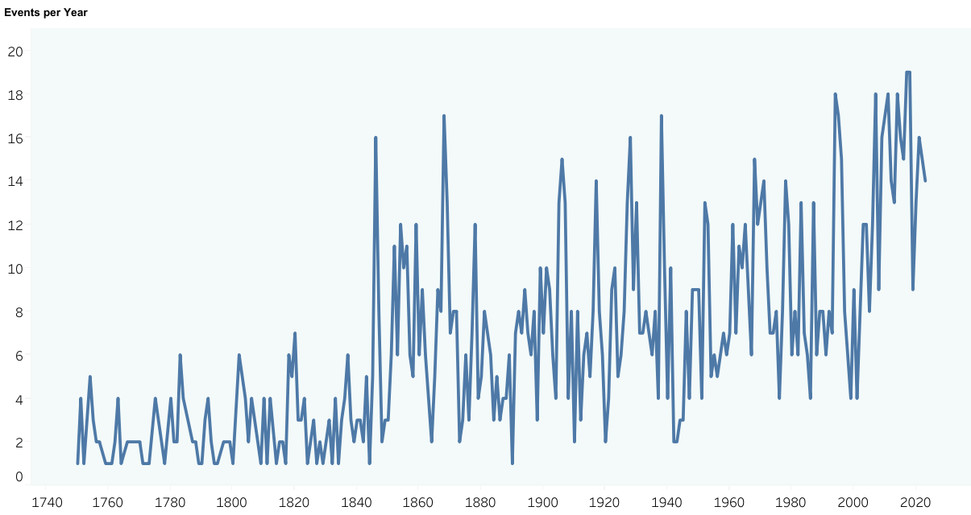
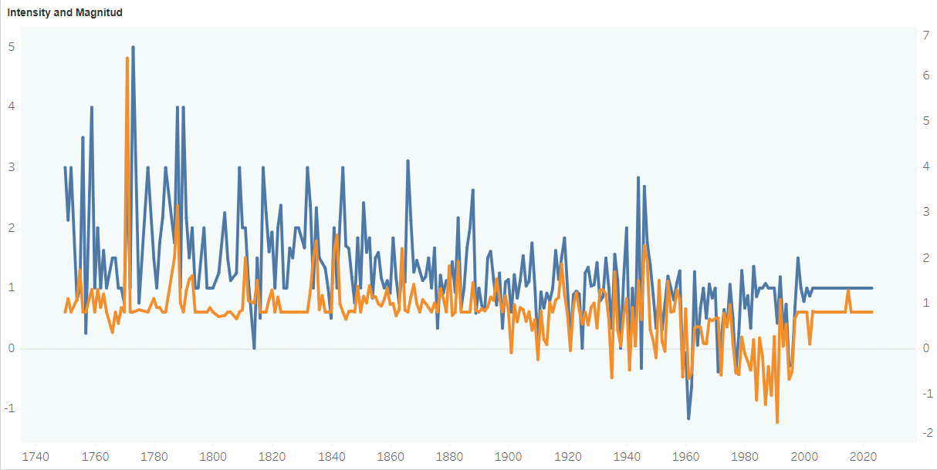

Slide 13
FINDINGS
Increased Frequency Over Time: There is a noticeable increase in the number of recorded tsunami events over time, particularly from the early 20th century onwards. This could be attributed to better detection and recording methods, along with a possible real increase in occurrences.
Temporal Patterns: The data does not indicate any strong temporal pattern in the occurrence of tsunamis related to specific months or days, suggesting that tsunamis occur relatively randomly throughout the year.
Long-Term Trends: Despite the variability in data, there is a long-term trend showing a rise in recorded events, which may necessitate increased attention to tsunami preparedness and mitigation strategies, especially in the most affected regions.

Slide 14
CONCLUSION
This study successfully employed standard data cleaning, wrangling, and exploratory data analysis to investigate tsunami occurrences since 1750, revealing a rise in events post-Industrial Revolution and identifying earthquake-prone regions like Japan, Indonesia, and the USA as the most affected areas. The project adeptly pinpointed earthquakes as the leading cause of tsunamis and established a correlation between tsunami deposits and impact severity. While robust in its current analytical methodologies, the project's future could be strengthened by incorporating predictive modeling and a broader scope of data to enhance the understanding of tsunamis' patterns and risks, paving the way for more informed disaster preparedness and mitigation strategies.

Slide 15
APPENDIX

Slide 16
Dropped Column Name | Reason
Unnamed: 0 | Column contain no data
Id | Does not provide any useful information for the analysis
Hr | This degree of time information is not required
Mn | This degree of time information is not required
Sec | This degree of time information is not required
Vol | Source data set provides a link to information about volcanic eruption pertaining to the tsunami event.
More Info | Source data set provides a link with more information about the specific event.
Tsunami Magnitude (Abe) | 99.9% missing values
Warn Status | 97% missing values
Missing | 99.8% missing values
Missing Description | 99.8% missing values
Injuries | 96.8% missing values
Injuries Description | 96.3% missing values
Houses Destroyed | 96.5% missing values
Houses Destroyed Description | 90.5% missing values
Houses Damaged | 99.3% missing values
Houses Damaged Description | 97.4% missing values
Total Death Description | Total data also includes source event (earthquake, volcano eruption etc.) statistics which are not of interest for this analysis.
Total Missing | Total data also includes source event (earthquake, volcano eruption etc.) statistics which are not of interest for this analysis.
Total Missing Description | Total data also includes source event (earthquake, volcano eruption etc.) statistics which are not of interest for this analysis.
Total Injuries | Total data also includes source event (earthquake, volcano eruption etc.) statistics which are not of interest for this analysis.
Total Injuries Description | Total data also includes source event (earthquake, volcano eruption etc.) statistics which are not of interest for this analysis.
Total Damage ($Mil) | Total data also includes source event (earthquake, volcano eruption etc.) statistics which are not of interest for this analysis.
Total Damage Description | Total data also includes source event (earthquake, volcano eruption etc.) statistics which are not of interest for this analysis.
Total Houses Destroyed | Total data also includes source event (earthquake, volcano eruption etc.) statistics which are not of interest for this analysis.
Total Houses Destroyed Description | Total data also includes source event (earthquake, volcano eruption etc.) statistics which are not of interest for this analysis.
Total Houses Damaged | Total data also includes source event (earthquake, volcano eruption etc.) statistics which are not of interest for this analysis.
Total Houses Damaged Description | Total data also includes source event (earthquake, volcano eruption etc.) statistics which are not of interest for this analysis.

Slide 17
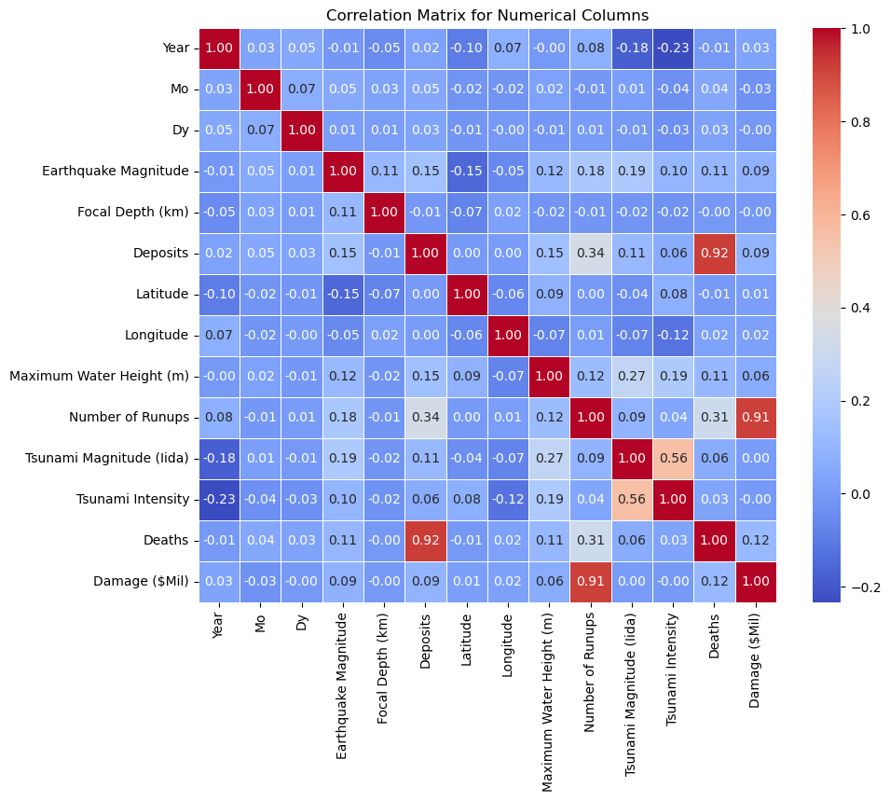

Slide 18
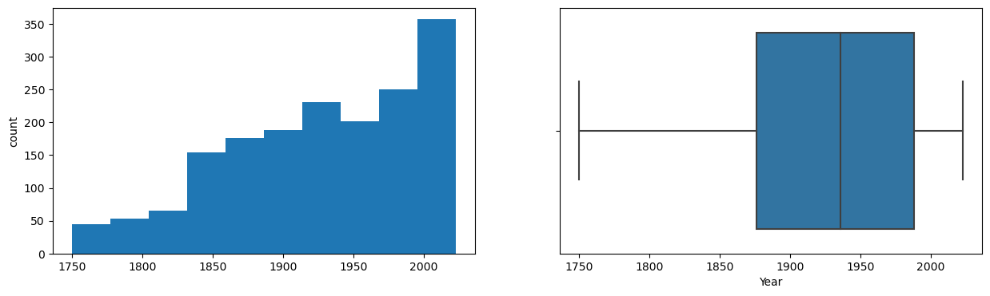
HISTOGRAM & BOXPLOT: YEAR

Slide 19
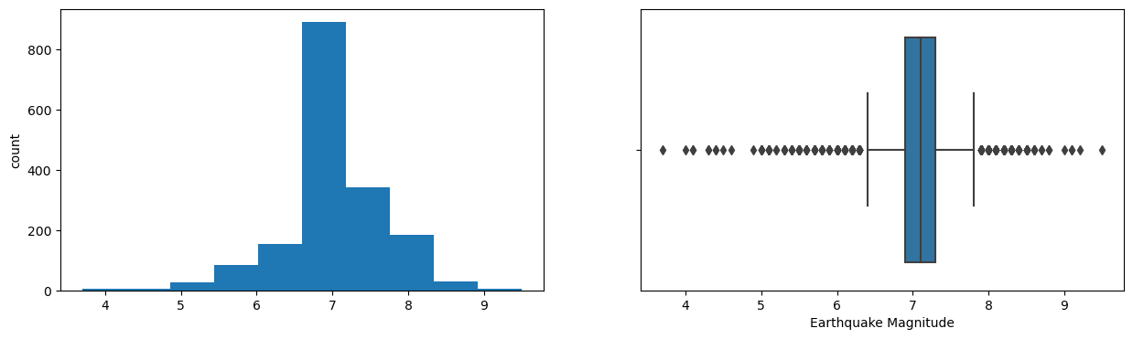
HISTOGRAM & BOXPLOT: EARTHQUAKE MAGNITUDE

Slide 20
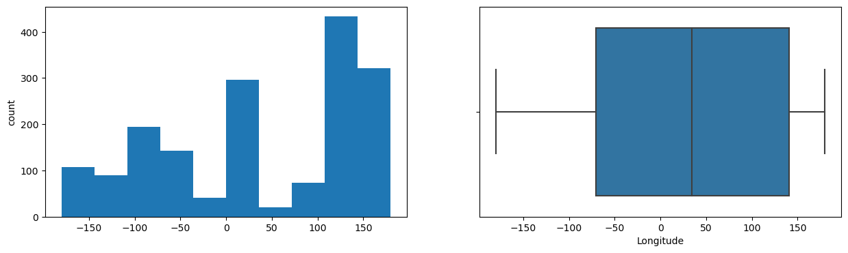
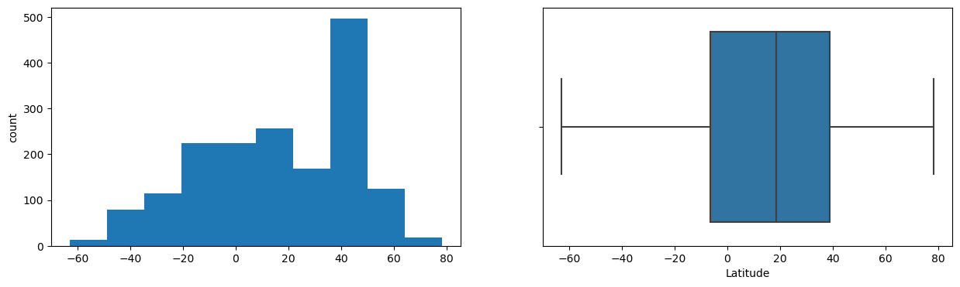
HISTOGRAM & BOXPLOT: LONGITUD & LATITUDE

Slide 21
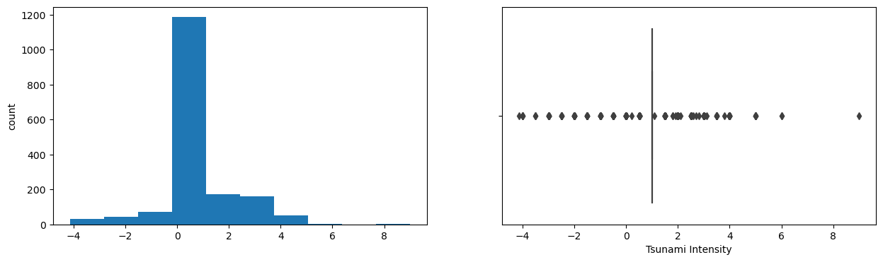
HISTOGRAM & BOXPLOT: TSUNAMI INTENSITY

Slide 22
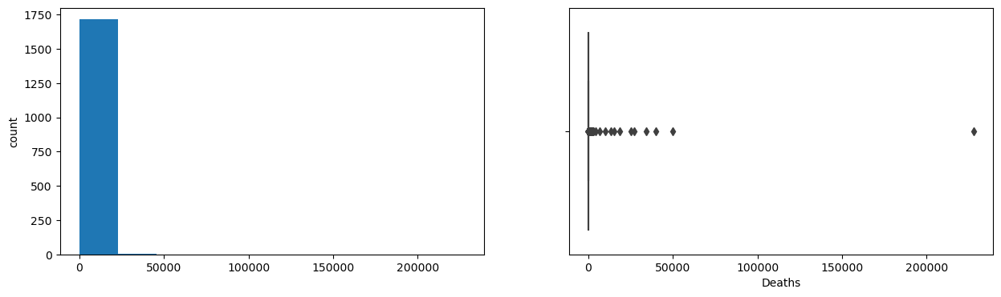
HISTOGRAM & BOXPLOT: DEATHS

Slide 23
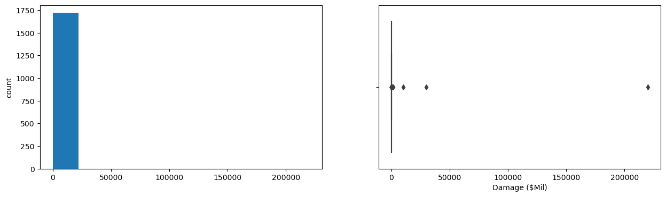
HISTOGRAM & BOXPLOT: DAMAGE

Slide 24
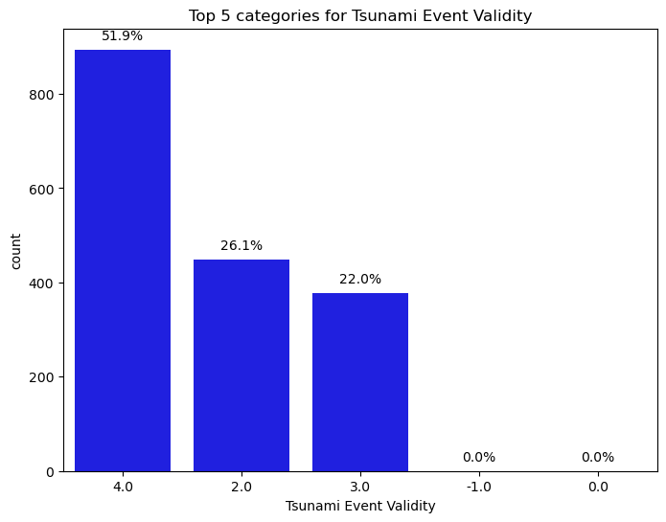

Slide 25
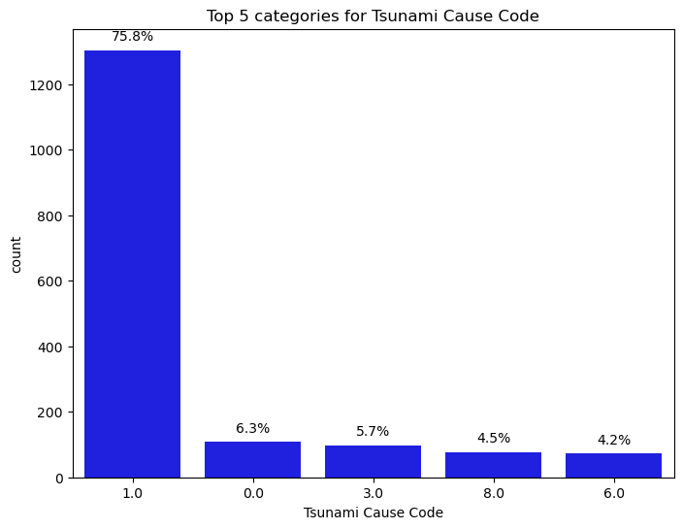

Slide 26
